Slide 1

CAR BLACK BOX
EMERTXE INTERNSHIP
R. Sham Hiruthik
NPR College of Engineering and Technology Dindugal,TamilNadu

Slide 2
REQUIREMENTS
MPLAB X IDE
XC8 COMPILER
PICSIMLAB
PIC 16F877A
16*2 CLCD
MKB
TIMER 2
TACTILE SWITCH

Slide 3
What is Car Black Box ?
A "black box" is either physically installed in the car
or downloaded as a smartphone app. It links to a
GPS device that measures and records vehicle speed, location, distance traveled, driving
frequency, and time of day the car is in motion.
Also known as an event data recorder (EDR) or
Accident data recorder (ADR)

Slide 4
Advantages
1. Reliable device.
2.Easy to extract the data .
3.Easy to analyze the recorded data.
4.It will not affect the privacy of driver.
5.Helpful to car manufacturer to improve the car design.
6.Help to investigation team
7.Help to Insurance Company
8.If it is connected to GPS system
9.Module alerts the accident to present mobile numbers stored in it.
10. The alert message includes the location in latitude and longitude.
Disadvantages
As the black box mainly consists of electronic circuit, there are chances of Damage

Slide 5
Microprocessors and Microcontrollers
Microprocessor consists of only a Central Processing Unit, whereas Micro Controller contains a CPU, Memory, 1/O all integrated into one chip
Microprocessor is used in Personal Computers whereas Micro Controller is used in an embedded system.
Microprocessor uses an external bus to interface to RAM, ROM, and other peripherals, on the other hand, Microcontroller uses an internal controlling bus.
Microprocessors are based on Von Neumann model Micro controllers are based on Harvard architecture
Microprocessor is complicated and expensive, with a large number of instructions to process but Microcontroller is inexpensive and straightforward with fewer instructions to process.

Slide 6
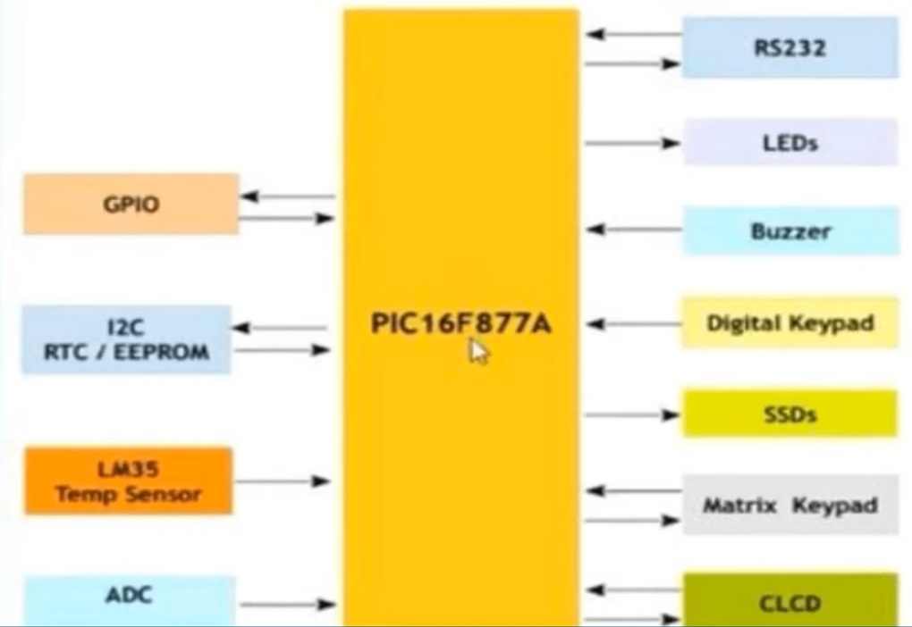
PICSIMLAB (PIC16F877A)

Slide 7
CLCD
CLCD - Character Liquid Crystal display.
In PICSimLab there are 2 types of Display --1. 16x2 Display 2. 16x4 Display
It display the ASCII character and some special characters.
It is most commonly used display.
2 types of communication modes : 4-Bit Mode, 8 - Bit Mode

Slide 8
ISR
ISR - Interrupt Service Routine; An ISR is a software routine that hardware invokes in response to an interrupt.
ISR attends to the request of an interrupting source by clearing the interrupt flag and should save register contents that may be affected by the code in the ISR. It must be terminated with the instruction RETIE.
When an interrupt occurs, the MPU completes the instruction being executed then it disables global interrupt enable. Places the address from the program counter on the stack

Slide 9
INTERRUPTS
An interrupt is a communication process set up in a microprocessor or a microcontroller in which an internal or external device request the MPU or MCU to stop the processing.
Then the MPU or MCU acknowledges the request and attends to the request. Goes back the processing where it was got interrupted.
Polling :
. It is the process where the computer or controlling device waits for an external
device to check the readiness or state, often with low-level hardware.

Slide 10
TIMERS
Timer is an important application in any embedded system which is a default peripheral which maintains the timing of an operation in sync with a system clock or an external clock.
It has many applications such as measuring time and generating delays etc.,
TIMER/COUNTER is a software designed to count the time intervals between the events.
Resolution which is also called register width. (8 or 16 bit etc.,)
Tic is referred as the change from one number to the another number. It may be Up count or Down count.
Quantum which depends on the system clock setting is a measure of time which is responsible for the tick.
Scaling may be Pre-scalar or Post scalar (may be 1: 1, 1:8 etc.,)

Slide 11
PROJECT IMPLEMENTATION

Slide 12
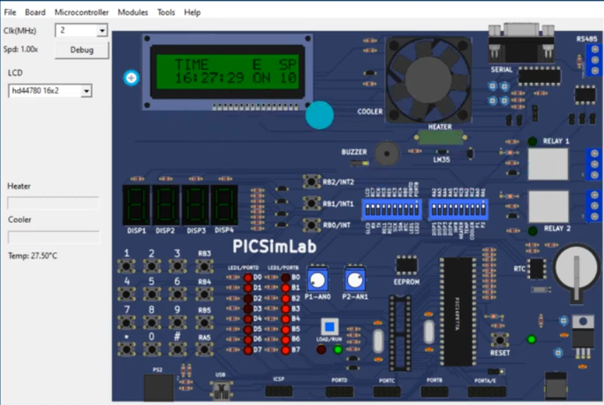
DASHBOARD SCREEN

Slide 13
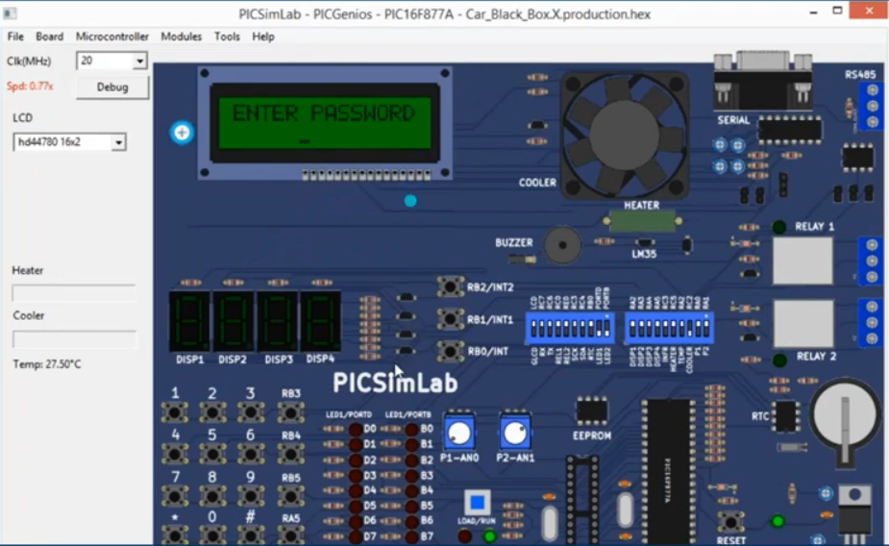
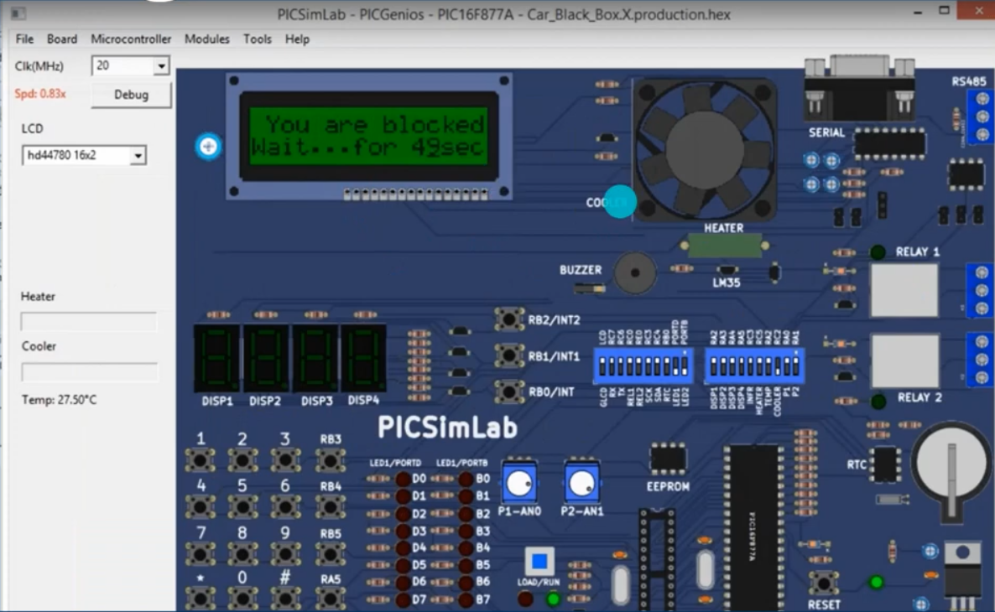
LOGIN SCREEN
BLOCKED SCREEN

Slide 14
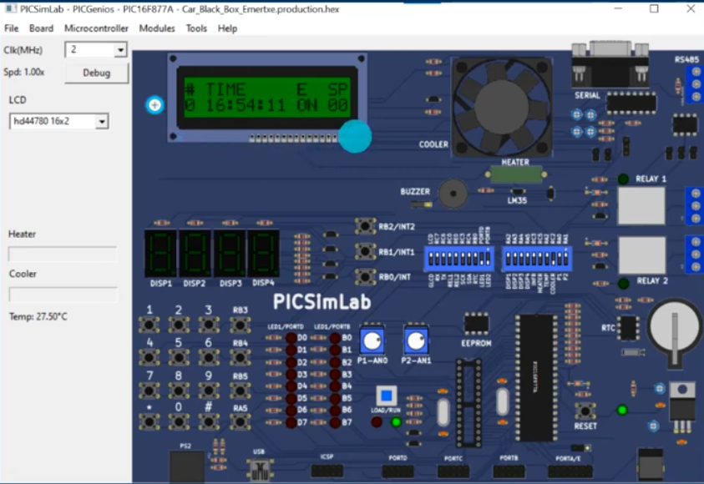
EVENTS

Slide 15
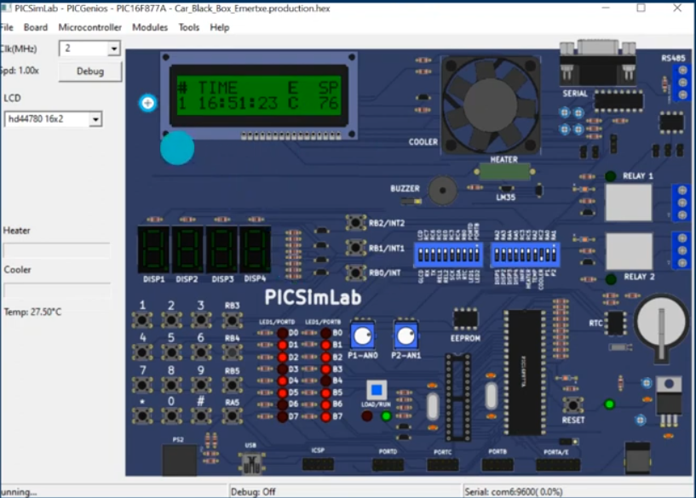
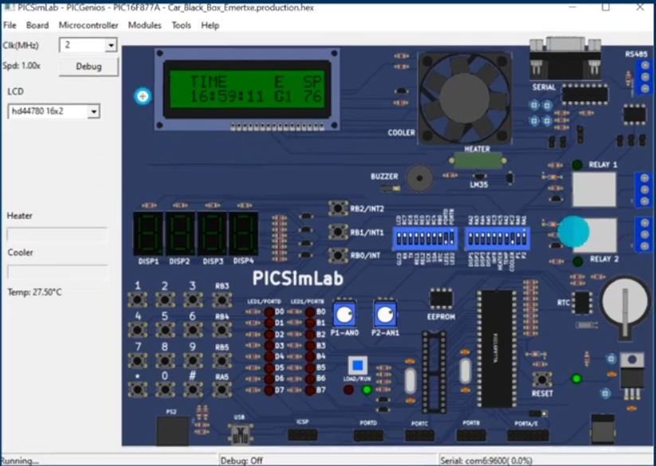
COLLISON EVENT
G EVENT

Slide 16
THANK YOU

